Slide 1
Chapter 4: Multithreaded Programming

Slide 2
Multithreaded Programming
Overview
Multithreading Models
Thread Libraries
Threading Issues
Operating System Examples
Windows XP Threads
Linux Threads

Slide 3
Objectives
To introduce the notion of a thread — a fundamental unit of CPU utilization that forms the basis of multithreaded computer systems
To discuss the APIs for the Pthreads, Win32, and Java thread libraries
To examine issues related to multithreaded programming
Notes:
什麼是Thread:使用CPU的最小單元 / CPU分配給程式的最小單元 。 一個process裡面可以有很多個Thread

Slide 4
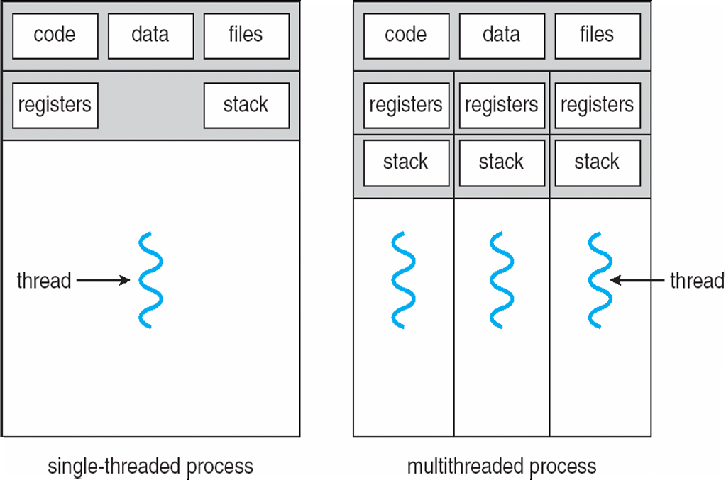
Single and Multithreaded Processes
Notes:
單Th 遇到IO 就必須等 有兩個Th 一個停 一個可以繼續 可想像只有一個程式段 Code只有一份 但是有5個Thread都在執行這一段 好像可以複製好幾份 每個Th有些做IO停住 有些不在IO的階段繼續跑 整個process因為裡面的Th有些持續輪流在動 所以CPU不容易被OS 所以之前都說CPU配給proc 這邊更細部的說法就是CPU是配給Th
每個Th來搶CPU 另外以timer 例如OS假設每20ms就會把CPU收走換其他人做輪流 單th就會停住 多th被輪到的機率比較高 所以proc保持在跑的機率和時間比較長
另外注意code data files單一共用 reg stack就是各自有
這邊context switch就是對Th作用 是儲存/恢復 Th的reg stack 這邊在ch3的說明有截在下一張
thread有點像是比較輕巧的process
一個proc可以產生好幾個th 每個th跟proc共用同一份code

Slide 5
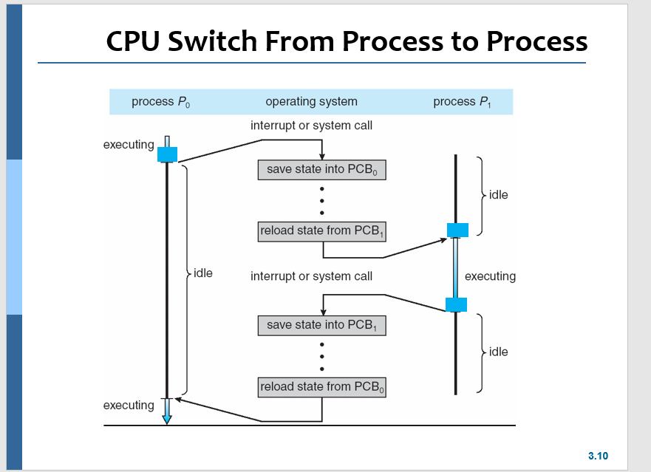
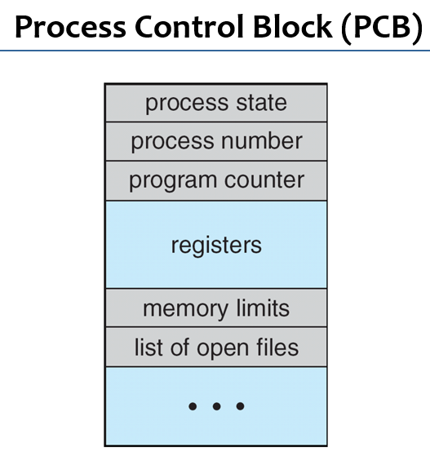

Slide 6
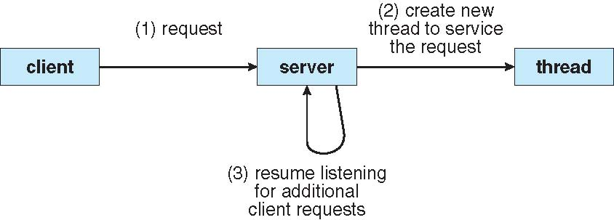
Multithreaded Server Architecture
Notes:
這邊接到要求 新另外開一個處理 然後繼續接聽 的機制 跟port概念相同

Slide 7
Benefits
Responsiveness: Multithreading an interactive application may allow a program to continue running even if part of it is blocked or is performing a lengthy operation,
thereby increasing responsiveness to the user.
For example, a multithreaded Web browser could allow user interaction in one thread while an image was being loaded in another thread.
Notes:
就是C# WPF

Slide 8
Benefits
Resource Sharing: Processes may only share resources through shared memory or message passing, arranged by the programmer.
Threads share the memory and resources of the process to which they belong by default.
The benefit of sharing code and data is that it allows an application to have several different threads of activity within the same address space.
如果是process要多個就要copy code data 等資料 成本就比較高 th是直接共用
Notes:
ok

Slide 9
Benefits
Economy: Allocating memory and resources for process creating is costly. Proc創建成本大 mem res
Because threads share the recourses of the process to which they belong, it is more economical to create and context-switch threads.
Th的context switch 成本小
In Solaris, creating a process is about 30 times slower than is creating a thread, and context switching is about 5 times slower.

Slide 10
Benefits
Scalability: The benefits of multithreading can be greatly increased in a multiprocessor architecture, where threads may be running in parallel on different processors.
Multithreading on a multi-CPU machine increases parallelism.

Slide 11
Multicore Programming
Multicore systems putting pressure on programmers, challenges include
Dividing activities 哪些部份的工作適合平行做
Balance 每個core的負載平均均衡
Data splitting
Data dependency
Testing and debugging
Notes:
4-3

Slide 12
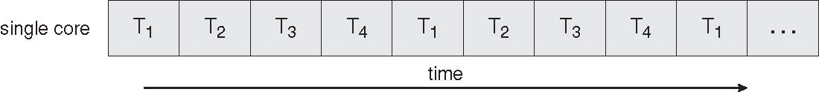
Concurrent Execution on a Single-core System
Notes:
一個core同一時間只能run一條Thread

Slide 13
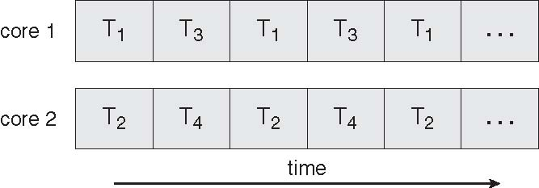
Parallel Execution on a Multicore System

Slide 14
Multithreading Models
Support for threads may be provided at user level, for user threads, or by the kernel, for Kernel threads.
User threads are supported above the kernel and managed without kernel support.
Kernel threads are supported and managed directly by the OS.
Virtually all contemporary當代的 operating systems, including Windows XP/2000, Solaris, Linux, Mac OS X, and Tru64 UNIX (formerly Digital UNIX), support kernel threads.
Notes:
Virtually 實際上，事實上，差不多 Kernel Thread機制也有保護OS的功用 user level的動作可能比較簡單 但是如果碰觸到IO 需要進到kernel level OS才能執行
OS設計不同 也有可能只提供 user 或 kernek TH

Slide 15
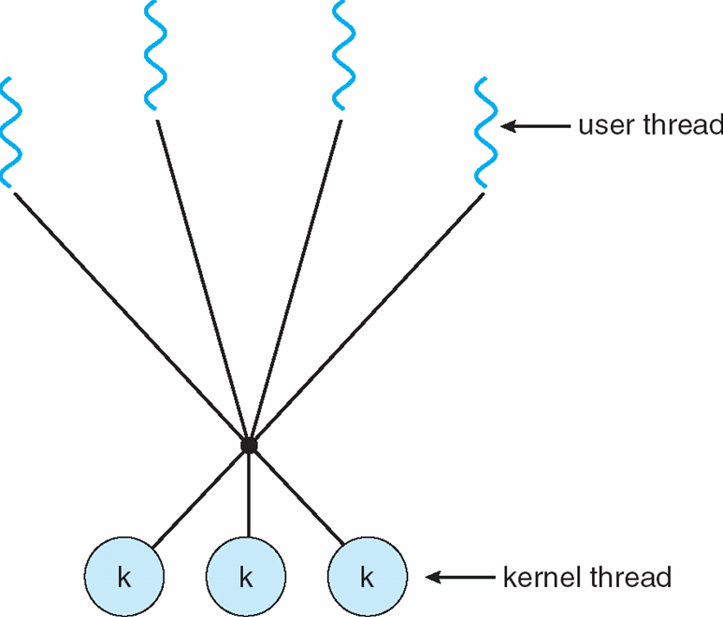
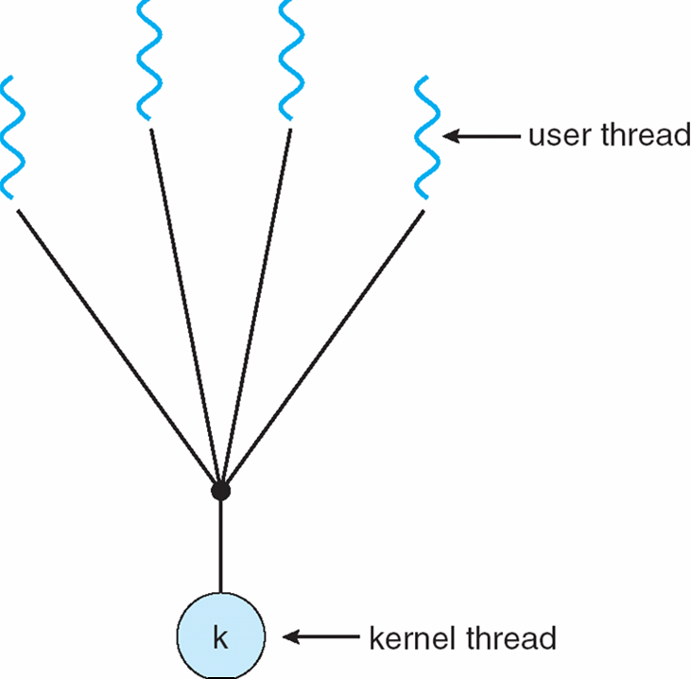
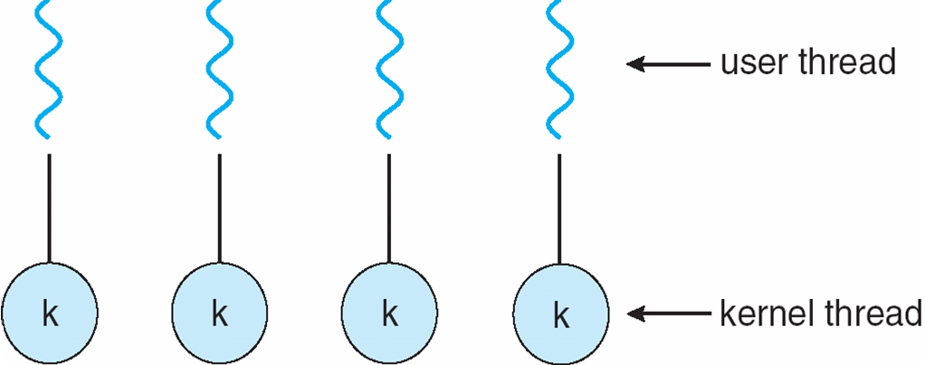
Multithreading Models
A relationship must exist between user threads and kernel threads.
Three common ways of establishing such a relationship:
Many-to-One
One-to-One
Many-to-Many

Slide 16
Many-to-One
Many user-level threads mapped to single kernel thread. Thread management is done by the thread library in user space, it is efficient.

Slide 17
Many-to-One
But the entire process will block if a thread makes a blocking system call.
Only one thread can access the kernel at a time, multiple threads are unable to run in parallel on multiprocessors.
Examples:
Solaris Green Threads
GNU Portable Threads
Notes:
如果Kenel Th遇到 IO 所有user th也會跟著暫停
GNU是一個自由的作業系統，其內容軟體完全以GPL方式釋出。 這個作業系統是GNU計劃的主要目標，名稱來自GNU‘s Not Unix!的遞迴縮寫，因為GNU的設計類似Unix，但它不包含具著作權的Unix代碼。
起源於1983年，持續不斷開發自由的Unix 風作業系統GNU，使電腦使用者能擁有分享這些軟體並改善的自由。

Slide 18
One-to-One
Each user-level thread maps to a kernel thread.
Allowing another thread to run when a thread makes a blocking system call.

Slide 19
One-to-One
Also allows multiple threads to run in parallel on multiprocessor.
Creating a user thread requires creating the corresponding kernel thread → Restrict the number of threads supported by the system
Examples
Windows NT/XP/2000
Linux
Solaris 9 and later
Notes:
ok

Slide 20
Many-to-Many Model
Multiplexes多路傳輸 many user level threads to a small or equal number of kernel threads
Notes:
ok

Slide 21
Many-to-Many Model
Allows the developer to create an many user threads as he/she wishes, true concurrency is not gained because the kernel can schedule only one kernel at a time.
But the kernel threads can run in parallel on a multiprocessor.
Also allowing another thread to run when a thread makes a blocking system call.
Solaris prior to version 9
Windows NT/2000 with the ThreadFiber package
Notes:
是 1-1 多-1 的折衷 1-1在th多的時候 對kernel的負擔會很重 例如user th 1000 ker th 也要1000 用many to many就可以例如只提供100 這也就是這頁第一點的意思

Slide 22
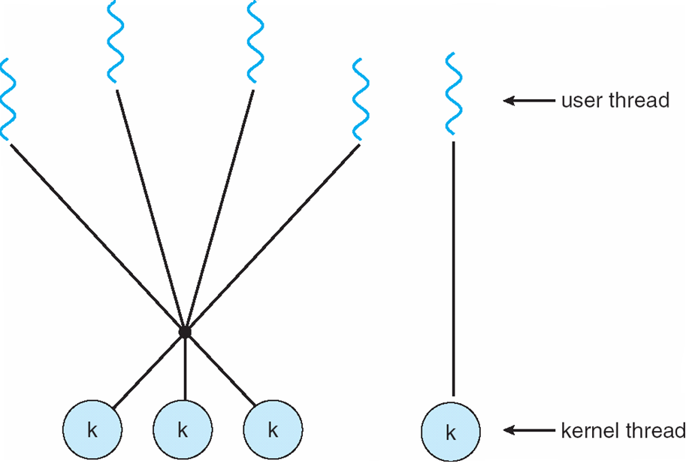
Two-level Model
One popular variation on the many-to-many model (called Two-level model) is that it also allows a user thread to be bound to a kernel thread
Examples
IRIX
HP-UX
Tru64 UNIX
Solaris 8 and earlier
Notes:
就是多-多 裡面也允許部分1-1

Slide 23
Thread Libraries
A thread library provides programmer with an API for creating and managing threads.
Two primary ways of implementing
Provide a library entirely in user space with no kernel support. All code and data structures for the library exist in user space. Invoking a function in the library results in a local function call in user space and not a system call.
Kernel-level library directly supported by the OS. Code and data structures for the library exist in kernel space. Invoking a function in the API of the library results in a system call to the kernel.

Slide 24
Thread Libraries
Three main thread libraries are in use today
POSIX Pthreads
Win32
Java
Pthreads may be provided as either a user- or kernel-level library
Win32 thread library is a kernel-level library
Java thread API allows threads to be created and managed directly in Java programs.
However, because the JVM is running on top of a host OS, the Java thread API is generally implemented using a thread library available on the host systems.
Notes:
可移植作業系統介面（英語：Portable Operating System Interface，縮寫為POSIX）是IEEE為要在各種UNIX作業系統上執行軟體

Slide 25
Thread Libraries
Let us describe basic thread creation using these three thread libraries.
Design a multi-threaded program that performs the summation of a non-negative integer in a separate thread using the well-known summation function
N=3, we have sum = 0+1+2+3 = 6
N = 5, we have sum = 0+1+2+3+4+5 = 15
N
Sum = Σ
i
i=0
Notes:
後面要設計一個程式 用thread lib來計算sum公式

Slide 26
Pthreads
May be provided either as user-level or kernel-level
A POSIX standard (IEEE 1003.1c) API for thread creation and synchronization
API specifies behavior of the thread library, implementation is up to development of the library
Common in UNIX operating systems (Solaris, Linux, Mac OS X)
Notes:
Solaris原先是昇陽電腦公司研製的類Unix作業系統，在Sun公司被Oracle併購後被稱作Oracle Solaris。目前最新版為Solaris 11。

Slide 27
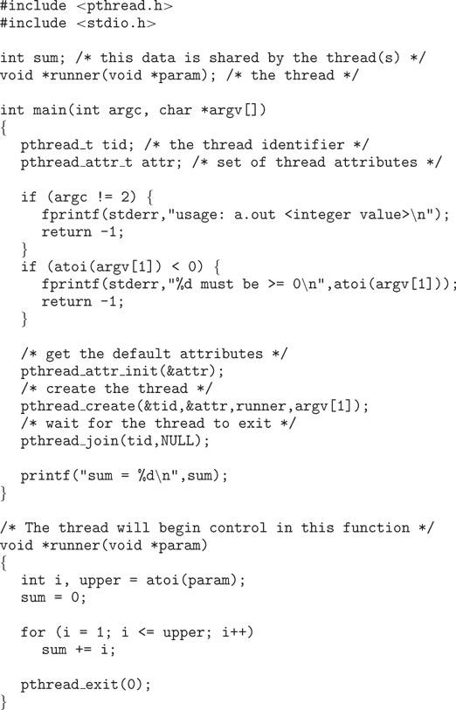
Multithreaded C program using the Pthreads API
Notes:
atoi(const char *str)轉換為字符串參數str為整數（int型）

Slide 28
Win32 Tthreads
The technique for creating threads using the Win32 thread library is similar to the Pthreads technique.
Data shared by the separate threads (sum) are declared globally.
Summation() function to be performed in a separate thread.
Threads are created using CreateThread() function. A set of attributes is passed to this function
Use WaitForSingleObject() function, which causes the creating thread to block until the summation thread has existed.
Notes:
Ok 感覺看起來 比較有熟悉感

Slide 29
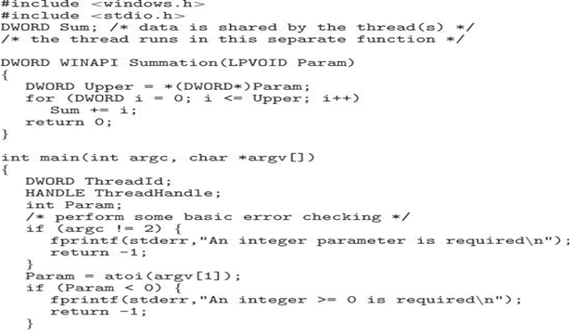
Multithreaded C program using the Win32 API
Summation() function

Slide 30
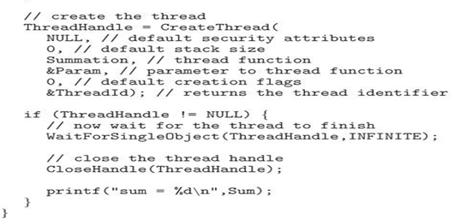
Multithreaded C program using the Win32 API

Slide 31
Java Threads
Java threads are managed by the JVM
Typically implemented using the threads model provided by underlying OS
Java threads may be created either:
To create a new class that is derived from the Thread class and to override its run() method, or
Define a class that Implements the Runnable interface (more commonly used).
When a class implements Runnable, it must define a run() method.
The code implementing the run() method is what runs as a separate thread.
Notes:
ok

Slide 32
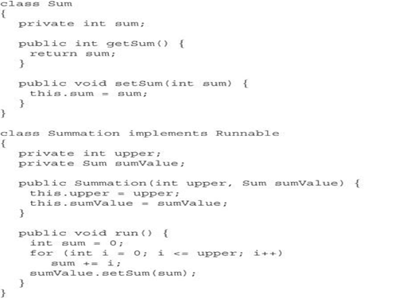
Java program for the summation of a non-negative integer
Run() method
Separate Thread

Slide 33
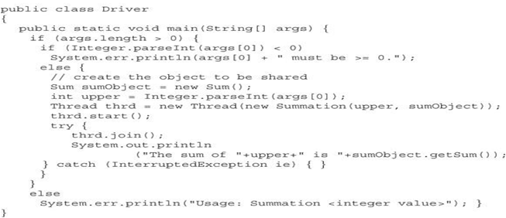
Java program for the summation of a non-negative integer

Slide 34
Threading Issues
Some of the issues to consider with multithreaded programs.
Semantics語意學 of fork() and exec() system calls
>有考慮Th 和只考慮proc 所說明的fork exec內容小有差別
Thread cancellation of target thread
Asynchronous or deferred
Signal handling
Thread pools
Thread-specific data
Scheduler activations

Slide 35
Semantics of fork() and exec()
Chapter 3 described how the fork() system call is used to create a separate, duplicate process.
The semantics of the fork() and exec() system calls change in a multithreaded program
If one thread in a program calls fork(), does the new process duplicate all threads, or is the new process single-threaded ?
Some UNIX systems have two versions of fork(), one that duplicates all threads and another duplicates only the thread that invoked the fork() system call.
If a thread invokes the exec() system call, the program specified in the parameter to exec() will replace the entire process – including all threads.
Notes:
ok

Slide 36
Semantics of fork() and exec()
Which of the two versions of fork() to use depends on the application.
If exec() is called immediately after forking, then duplicating all threads is unnecessary, as the program specified in the parameters to exec() will replace the process. In this case, duplicating only the calling thread is appropriate.
However, if the separate process does not call exec() after forking, the separate process should duplicate all threads.

Slide 37
Thread Cancellation
Terminating a thread before it has finished
Two general approaches:
Asynchronous cancellation terminates the target thread immediately
Deferred 推遲 cancellation allows the target thread to periodically 週期性地 check if it should be cancelled

Slide 38
Signal Handling
Signals are used in UNIX systems to notify a process that a particular event has occurred
A signal handler is used to process signals
Signal is generated by particular event
Signal is delivered to a process
Once delivered, the signal must be handled
Options:
Deliver the signal to the thread to which the signal applies
Deliver the signal to every thread in the process
Deliver the signal to certain threads in the process
Assign a specific thread to receive all signals for the process
Notes:
ok

Slide 39
Thread Pools
Create a number of threads in a pool where they await 等候(動詞 work
Advantages:
Usually slightly faster to service a request with an existing thread than create a new thread
Allows the number of threads in the application(s) to be bound綁定到(是bind過去分詞，不是真的bound彈跳) to the size of the pool
Notes:
類似connection pool

Slide 40
Thread Specific Data
Threads belonging to a process share the data of the process.前面講過
However, it is useful to allow each thread to have its own copy of data (thread-specific data)
For example, in a transaction-processing system, we might service each transaction in a separate thread. Each transaction might be assigned a unique ID. 一個trn一個thread達到分隔
To associate each thread with its unique ID, we could use thread-specific data.
Most thread libraries provide some form of support for thread-specific data.
Notes:
可見在eva一直磨練cn trn寫法概念 很有幫助

Slide 41
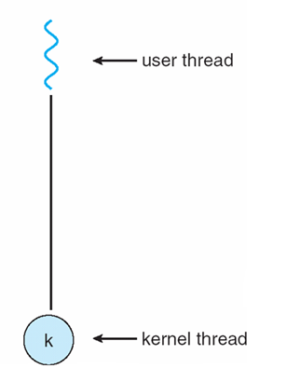
Scheduler Activations
Both M:M 多對多 and Two-level models require communication between the kernel and the thread library to dynamically adjust the appropriate number of kernel threads to ensure the best performance.
Lightweight process (LWP) – an intermediate data structure between the user and kernel threads.
To user-thread library, the LWP appears to be a virtual processor on which the application can schedule(列入計畫) a user thread to run.
Each LWP is attached to a kernel thread
If a kernel thread blocks → LWP blocks → user thread blocks.
LWP
Notes:
ok

Slide 42
Scheduler Activations
An application may require any number of LWPs to run efficiently.
A CPU-bound application running on a single processor.
Since only one thread can run at once, one LWP is sufficient.
An I/O-intensive application may require multiple LWPs to execute.
An LWP is required for each concurrent blocking system call.
For example, five different file-read requests occur simultaneously, then five LWPs are needed because all could be waiting for I/O completion in the kernel.
Notes:
ok

Slide 43
Scheduler Activations
Scheduler activation: one scheme for communication between the user-thread library and the kernel
The kernel provides an application with a set of virtual processors (LWPs), and the application can schedule user threads onto an available virtual processor.同前
The kernel must inform an application about certain events – upcall
Upcalls are handled by the thread library with an upcall handler, and upcall handlers must run on a virtual processor.
This communication allows an application to maintain the correct number of kernel threads
Notes:
ok

Slide 44
Operating System Examples
Windows XP Threads
Linux Threads
Notes:
44

Slide 45
Windows XP Threads
Implements the one-to-one mapping,
By using the thread library, any thread belonging to a process can access the address space of the process.
Each thread contains
A thread id
A register set representing the status of the processor同之前那張多緒圖
Separate user and kernel stacks
Private data storage area
The register set, stacks, and private storage area are known as the context of the thread
The primary data structures of a thread include:
ETHREAD (executive thread block)
KTHREAD (kernel thread block)
TEB (thread environment block)

Slide 46
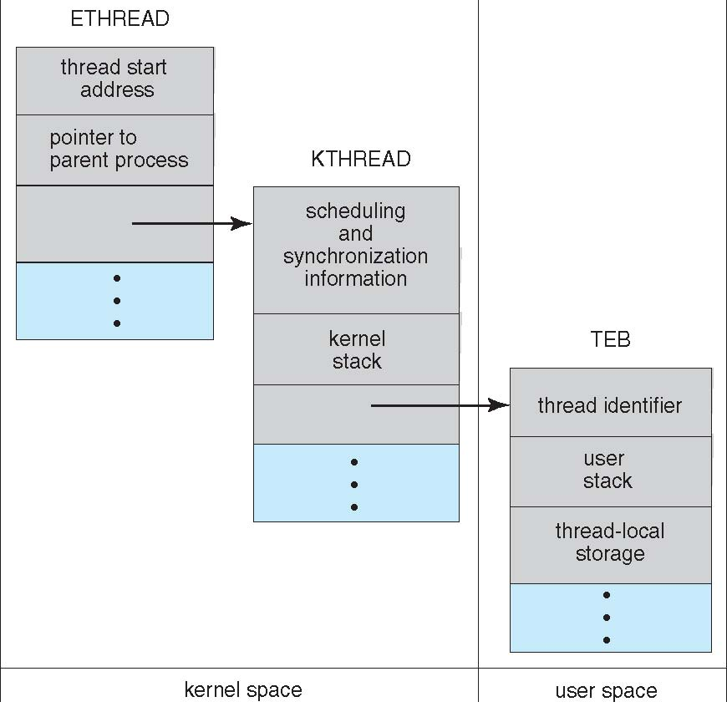
Windows XP Threads
Data Structures of a Windows XP thread

Slide 47
Linux Threads
Linux provides the fork() system call with the traditional functionality of duplicating a process.
Linux also provides the ability to create threads using the clone() system call
However, Linux does not distinguish between processes and threads.
Linux refers to them as tasks rather than processes or threads
When clone() is invoked, it is passed a set of flags, which determine how much sharing is to take place between the parent and child tasks.

Slide 48
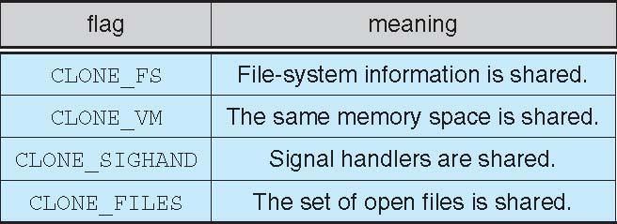
Linux Threads
For example, if clone() is passed the flags CLONE_FS, CLONE_VM, CLONE_SIGHAND, and CLONE_FILES, they will share the same file-system information, the same memory space, the same signal handler, and the same set of open files.

Slide 49
End of Chapter 4

